Slide 1
Employer Disclosure
Hello! Thanks for taking a look at some of my schoolwork
This presentation is a taste of my final project for PETE 4161: Data Analytics for Petro. Industry
A reference to this project can be found on my resume under “Well Production Data Analysis”
This course covered topics such as: Stat. Learning, Machine Learning, Computer Vision, Neural Networks and more!

Slide 2
Project Presentation PETE 4161 for Dr. Tyagi
Keenan Flynn
Notes:
Hey everyone, name Keenan
Thanks for listening to my presentation summarizing the 2 projects we did for this class

Slide 3
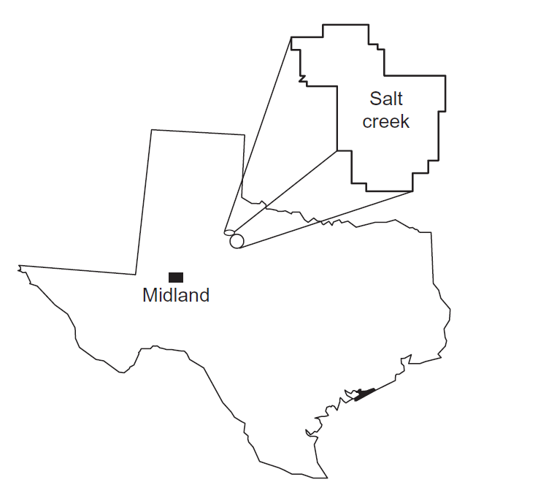
Project 1
Data Exploration, Dimensional Reduction, Unsupervised and Supervised Learning (Classification and Regression)
Notes:
The first project was an examination of salt creek data set
Midwestern Texas
This project encompass
Data Exploration
Dimensional reduction
Unsupervised Learning in form of clustering
Classification and Regression

Slide 4
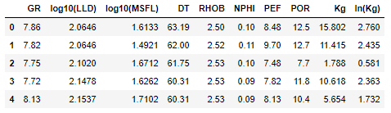
Salt Creek Dataset
Suite of 7 well logs with interpreted porosity and permeability. End goal of predicting electrofacies class and permeability
Notes:
The salt creek set consists of well log info from 7 wells in Permian Basin
Highly heterogenous carbonate reservoir
In theory see statistical significance between the wells
7 well logs -> name
#GR -> Gamma Ray Log
#LLD -> Laterolog Deep
#MSFL -> Micro Resistivity
#DT -> Sonic Log
#RHOB -> Density log
#NPHI -> Neutron density
#PEF -> photoelectric absorption
Measured perms/porosity for each data point

Slide 5
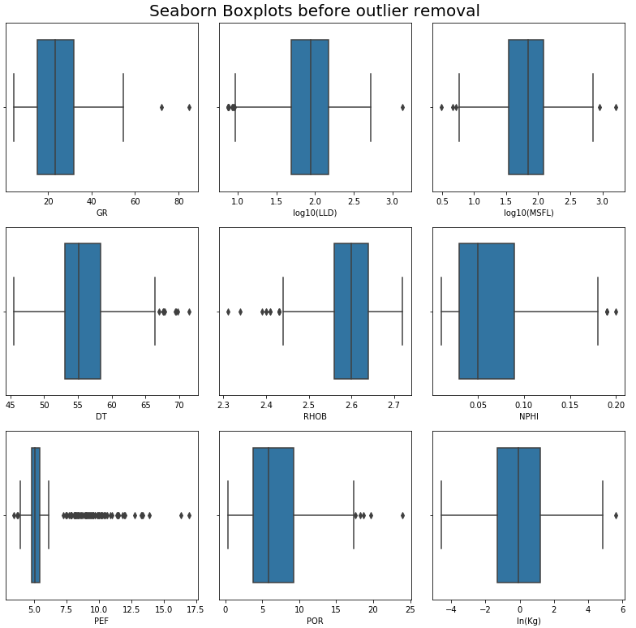
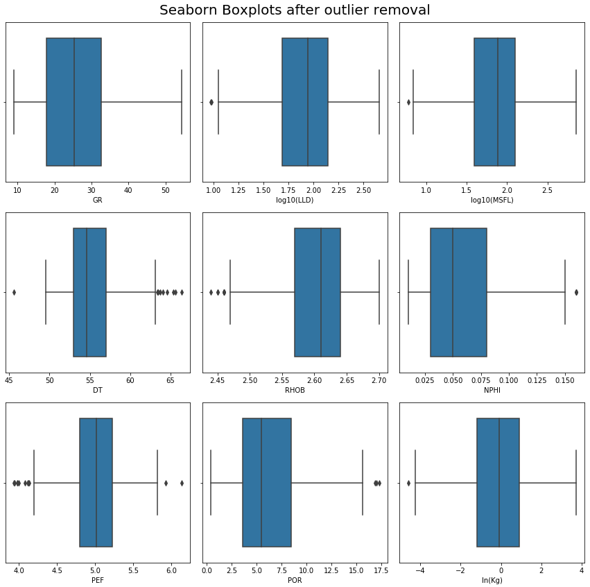
Data Exploration
Notes:
Data Exploration is first step in preprocessing the data to fit in our learning models
Much work already done, each column is 64 digit float, there are no duplicates in the data
Remove outliers, visualized through seaborn boxplots
PEF shows the most radical transformation with many outliers removed
Outlier removal done through IQR method
First and Third quartile were found for the entire dataset, the difference=IQR
If a datapoint lays a distance of 1.5*IQR behind the first quartile or in front of the third quartile it was removed
1.5 industry standard

Slide 6
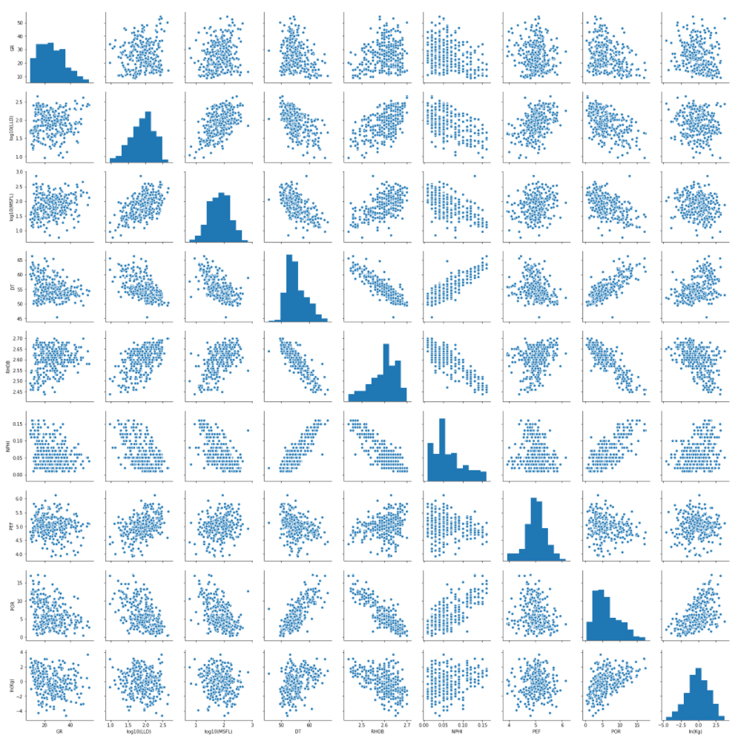
Data Exploration
Notes:
Finally pairwise relationships were evaluated using seaborns pairplot
Scatter plots show relationships between variables and diagonal histograms show relationship within variables
We can see that outlier removal got us to a point where we have some good looking gaussian or lognormal distributions in each attribute with a few hiccups here and there

Slide 7
Dimensional Reduction (PCA)
Standardization of Data
Eigen decomposition
Total variance of each Principal Component
Discard Components with marginal explained variance
Notes:
Before the data can be modeled in machine learning, we must reduce the dimensions.
First the data was standardized by subtracting the mean and dividing by stan dev for each point
Next an Eigendecompositon was performed using numpy linear algebra suite, giving us 7 principal components
Each of these components describes a certain amount of variance of the data and the components that describe the least were dropped

Slide 8
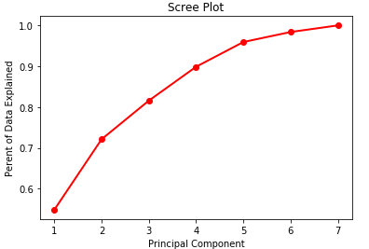
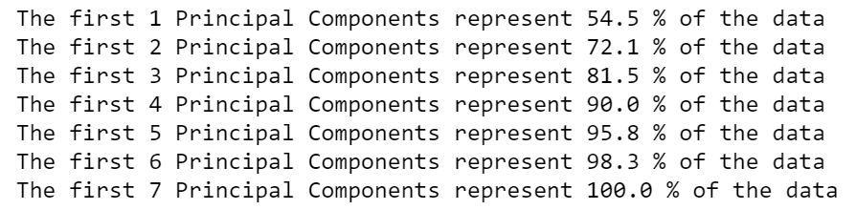
Dimensional Reduction (PCA)
Notes:
Here you can see the process that was used to drop the extra PCs.
I chose an arbitrary value of 90% of total variance that my PCs needed to describe which correlated to exactly 4 PCs
I also used a scree plot, however it didn’t have any point where there was a clear elbow so it was less useful

Slide 9
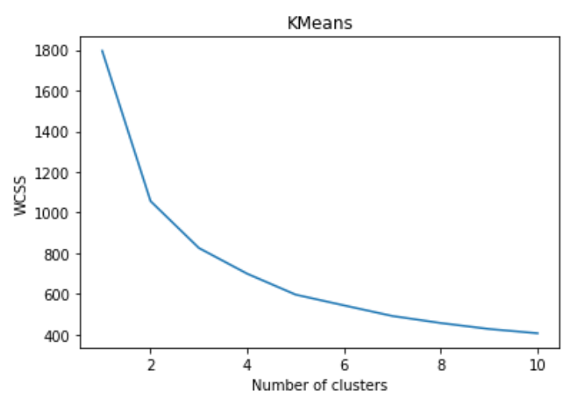
Unsupervised Learning (K means)
Notes:
With an array of the PCs, we can now begin machine learning
First the data was put through K means clustering, which is unsupervised
To choose the right amount of clusters we want to minimize the WCSS score or the within cluster sum of squares
We can visualize this by making another elbow plot. This time our plot gives us a pretty good elbow and through testing I decided that 6 was the right amount of clusters

Slide 10
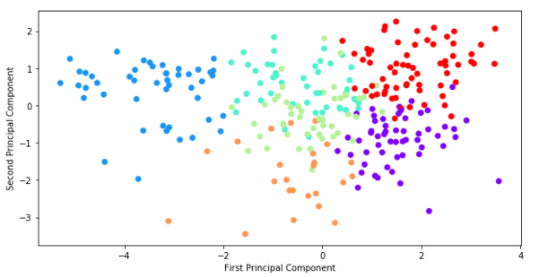
Unsupervised Learning (K means)
Notes:
Once num clusters known, we can simply use 2 lines of code to split the data
Each data point is now assigned a label
Scatter plot all data with the color representing a cluster
Each cluster represents an electrofacies
The reason there is overlap is because the labels were created from clustering all 4 Principal Components and this plot is only projecting 2 of the four PCs

Slide 11
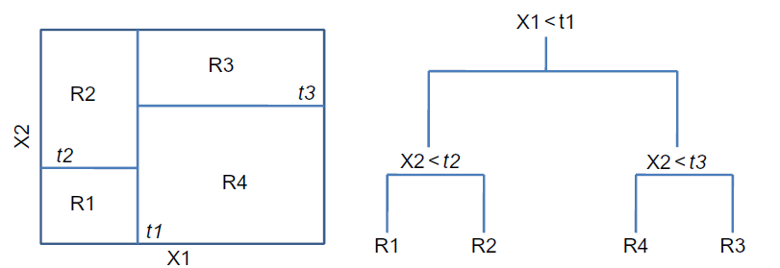
Supervised Learning (Classification)
Notes:
With defined classes, we can now classify
The classification method I chose was a Random Forest of 100 decision trees
Better because than a single decision tree because that could overfit our data
Each tree works by asking a logical question on each level
For example, if x value less than t1……… electrofacies R1

Slide 12
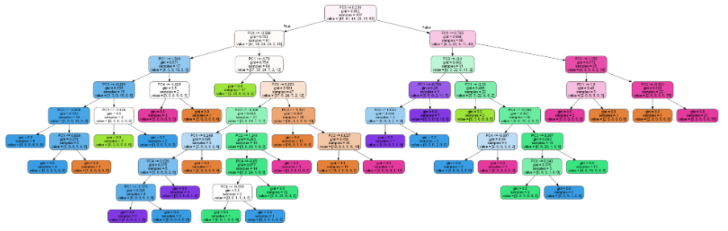


Supervised Learning (Classification)
Notes:
This is what one of the trees looks like
First line = logical expression
Second line is the split criterion, measures quality of split
Third line = num samples
Cluster numbers of all those samples
Unrestricted depth of levels

Slide 13

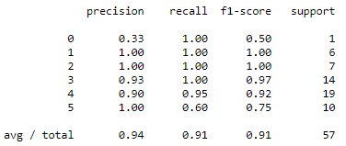
Supervised Learning (Classification)
Average accuracy score of 90%!!!
Notes:
These are the results of the classification
In this run it only classified 4 data points falsely
Precision, recall, f1 all above 90%
Total Accuracy score of the model averages above 90%

Slide 14
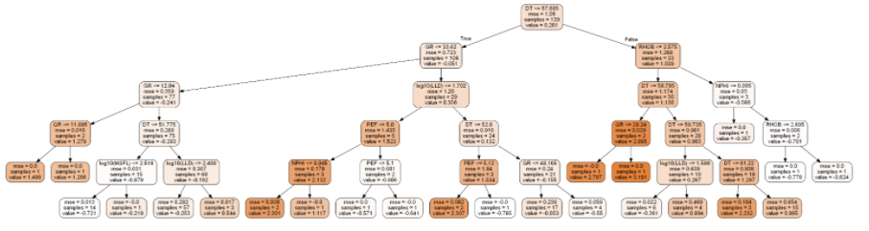



Supervised Learning (Regression)
Still some work to do
Notes:
Very similar to the classification random forest, I used a regression forest to try to predict perm
Input values were the principal components, with expected outcomes to be permeabilities
First line = split
Second measures quality of split
Samples
Scores for the model
R2 is very low and I couldn’t even get it to be positive, so theres some work to be done still with more time

Slide 15
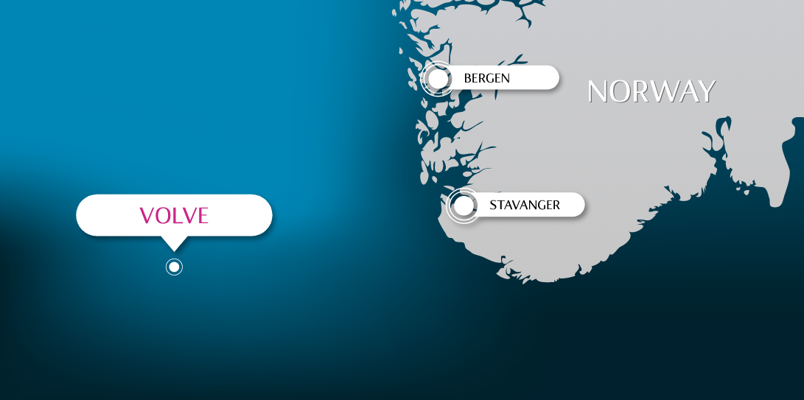
Project 2
Time Series: Data Exploration, Persistence Modeling, Neural Network (LSTM) training, testing and validation
Notes:
Project 2
Examination of time series data from the Volve Field
Off coast of Norway
In this project I did some……..

Slide 16
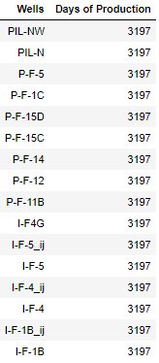
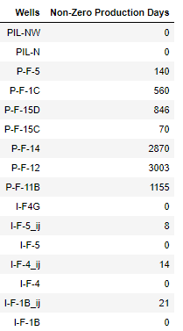
Data Exploration
Notes:
16 wells in the dataset, conveniently they each have 3197 days of production.
Starting on January 1, 2008
Ending on Oct 1, 2016
For most wells, a majority of Production days were zeros, so I removed any zero days of production to find………
In this project I will fit models to well P-F-14 and try to validate my results on P-F-12

Slide 17
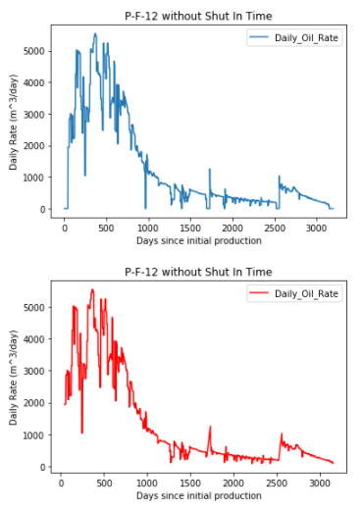
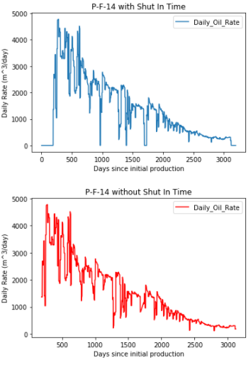
Data Exploration
Notes:
For each well there was about 50 attributes
Daily Oil, water, gas
Cum Oil water gas
Daily liquid, cum liquid
Pressure data
I chose to focus on just 2 of these attributes
Days since January 1, 2008 and Daily Oil rate
Both wells have similar production
Upwards slope while coming online, downward concave after reaching peak
You can see the effects of removing zero days of production
Bit of a smoother line

Slide 18
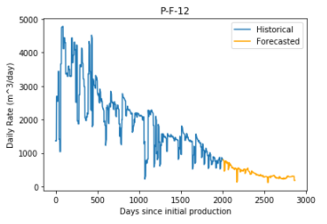
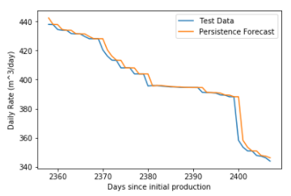

Persistence Model
Notes:
For supervised learning I did a persistence model
The persistence forecast is where the observation from the prior time step (t-1) is used to predict the observation at the current time step (t).
Good in sections where it is flat…..show…. little error
Not so good in sections with large increase/decrease
Drawback of this is limited horizon of just 1
High r2 in my case

Slide 19
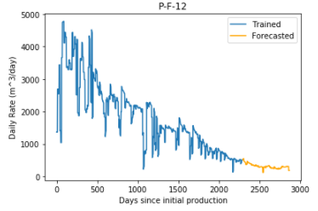
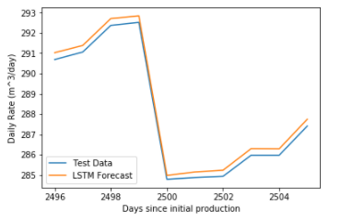

LSTM Model
Notes:
LSTM is supposed to be able to have a longer horizon than other types on models that aren’t covered under machine learning
It is recurrent neural network
Learn/remember over long sequences
Used LSTM that
Model was fit with about an 80/20 split
To get our data into formatting for LSTM
Transform data into a supervised learning problem
Input of t-1 and output of t1
Transform data to stationary
Removes the trend from data by differencing the data
Finally scale the data so that it lies between -1 and 1
Mean square error is lower than persistence model by about 15
Only forecasting 1 value ahead

Slide 20
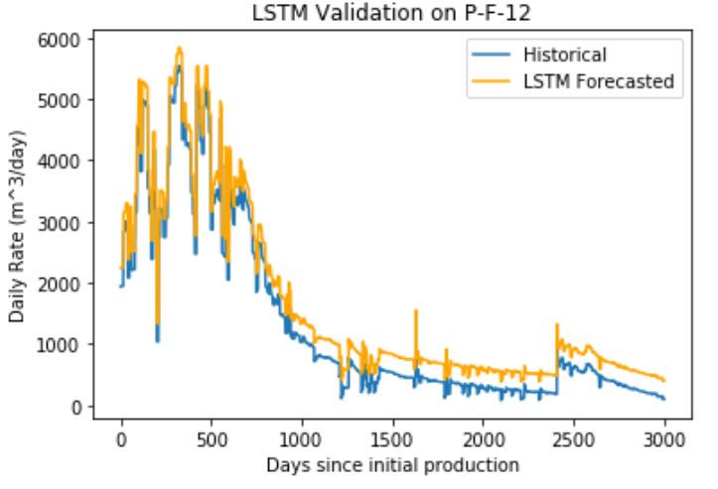
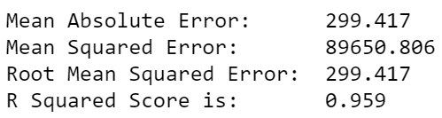
Validation

Slide 21
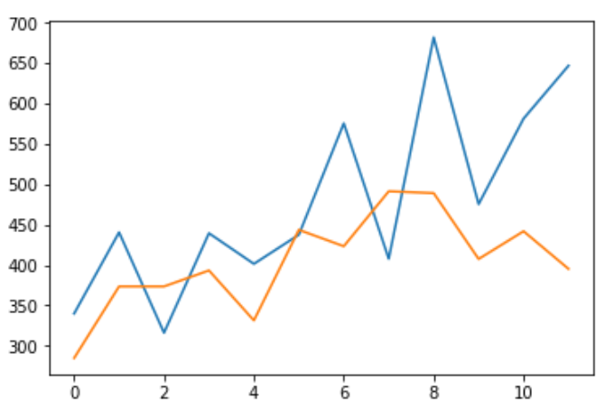
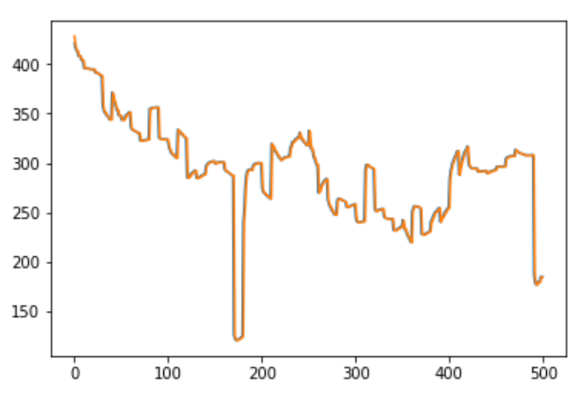
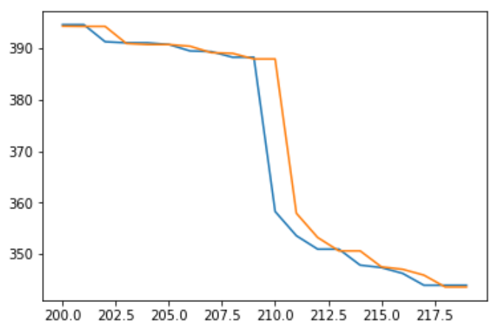
Validation

